Slide 1

CSE 591 An Introduction to Graph Theory
Ross Maciejewski
rmacieje@asu.edu

Slide 2
Visualizing Graphs
Last time, we talked about visualizing graphs
Discussed optimizing graph aesthetics for layouts
Planarity
Edge Crossing
Adding interaction
Now we want to discuss what sorts of metrics and measurements we can use to learn about graphs

Slide 3
So Why Formal Methods?
Up until now, we’ve talked about how we can visualize the data and look for patterns and relationships
However, we know that graph drawing is hard, there are many ways to layout a graph, and the visual representation may not always let us see all the patterns
By using formal representations of the data, patterns are stored within the computer, and we can begin asking various questions of the data
We can answer these questions by using both analysis and visualization!

Slide 4
Why Formal Methods?
Suppose we are analyzing the structure of friends, and we have four people: A, B, C and D. Suppose that A likes C and not B, C likes D but not A or B, and D likes A, B and C.
We now know the group dynamics; however, it’s hard to look for patterns in this statement
We want to be able to ask questions of our data, and we want to have analytical ways to answer these questions that can aid the visualization!

Slide 5
What is a Graph?
Vertices (nodes) connected by Edges (links)
We have several ways to represent a graph
Adjacency list
Adjacency matrix (this is analogous to the weights matrix in last lecture)
Adjacency List
1:3
2:3
3:1,2
2
1
3
 | 1 | 2 | 3
1 | 0 | 0 | 1
2 | 0 | 0 | 1
3 | 1 | 1 | 0

Slide 6
Some Easy Statistics
Using the adjacency matrix representation, each entry represents the count of the number of pathways between two nodes that are of length 1
The adjacency matrix squared represents the count of the number of pathways between two nodes that are of length 2
The adjacency matrix cubed represents …
Why do we care?
Many questions about networks deal with how connected things are.

Slide 7
Some Easy Statistics
We can also compute the means and standard deviations of the rows and columns in the adjacency matrix
The mean tells us what percent of all possible ties are present
The standard deviation would tell us how much variation there is among elements
The rows would compute the outdegree, and the columns would compute indegree
Ok, but what about computing the distributions of a graph?

Slide 8
Random Graph Models
Random graphs are graphs generated by some random process
Given a starting set of n vertices, add edges between them at random, different graphs will be obtained depending on how the edges are added
Edgar Gilbert Model¹ – every possible edge occurs independently with probability p
Erdos-Renyi Model² – assigns equal probability to all graphs with exactly M edges, also called the Rado Graph
1 - Gilbert, E. N. (1959), "Random graphs", Annals of Mathematical Statistics 30: 1141–1144
2 - Erdős, P. Rényi, A. (1959) "On Random Graphs I" in Publ. Math. Debrecen 6, p. 290–297

Slide 9
Random Graph Models
Random Graph Process – stochastic process that starts with n vertices and no edges
At each time step, one new edge is added chosen uniformly from the set of missing edges
The Erdos-Renyi model can be seen as a snapshot of this process at a given time M

Slide 10
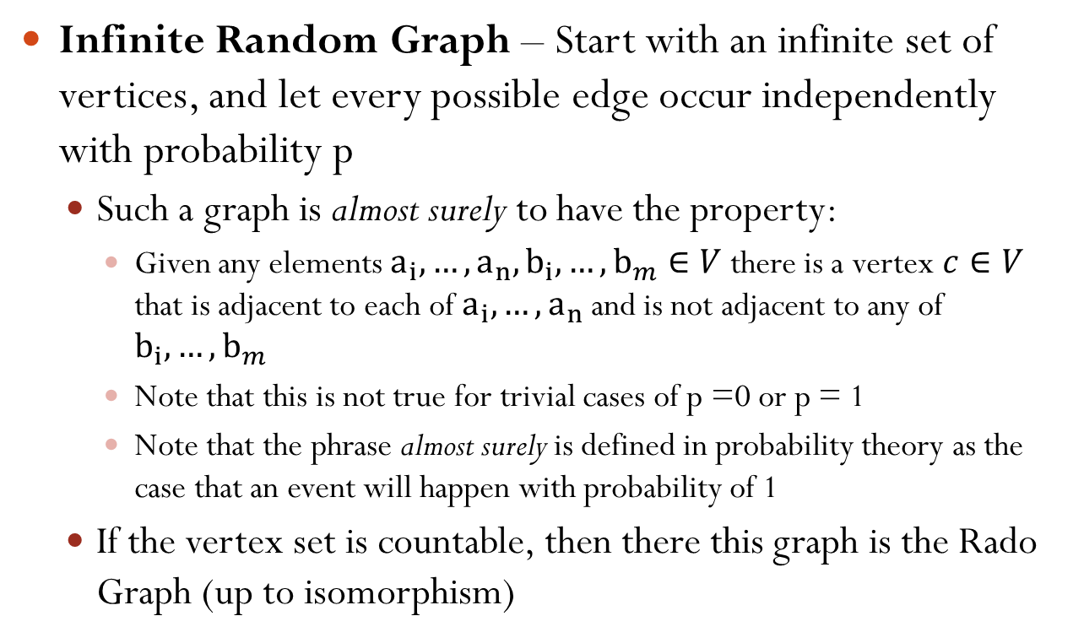
Random Graph Models
Infinite Random Graph – Start with an infinite set of vertices, and let every possible edge occur independently with probability p
Such a graph is almost surely to have the property:
Given any elements $a_{i}, …, a_{n}, b_{i}, …, b_{m}∈V$ there is a vertex $c∈V$ that is adjacent to each of $a_{i}, …, a_{n}$and is not adjacent to any of $b_{i}, …, b_{m}$
Note that this is not true for trivial cases of p =0 or p = 1
Note that the phrase almost surely is defined in probability theory as the case that an event will happen with probability of 1
If the vertex set is countable, then there this graph is the Rado Graph (up to isomorphism)

Slide 11
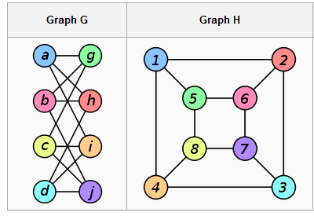
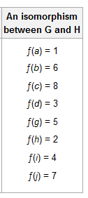
Graph Isomorphism
An isomorphism of graph G and H is a bijection between the vertex sets of G and H such that any two vertices u and v of G are adjacent in G if and only if f(u) and f(v) are adjacent in H
This kind of bijection is typically called edge-preserving
In this definition, the graphs are undirected, non-labeled and non-weighted
Isomorphism Example taken from Wikipedia: http://en.wikipedia.org/wiki/Graph_isomorphism

Slide 12
Graph Isomorphism
WhitneyTheorem – two connected graphs are isomorphic if and only if their line graphs are isomorphic
Exception – The complete graph on three vertices and the complete bipartite graph are not isomorphic; however, their line graphs are isomorphic
Determining if two finite graphs are isomorphic is NP
Subgraph Isomorphism – given two graphs G and H, determine whether G contains a subgraph that is isomorphic to H (this problem is NP complete)
H. Whitney, "Congruent graphs and the connectivity of graphs", Am. J. Math., 54(1932) pp. 160–168

Slide 13
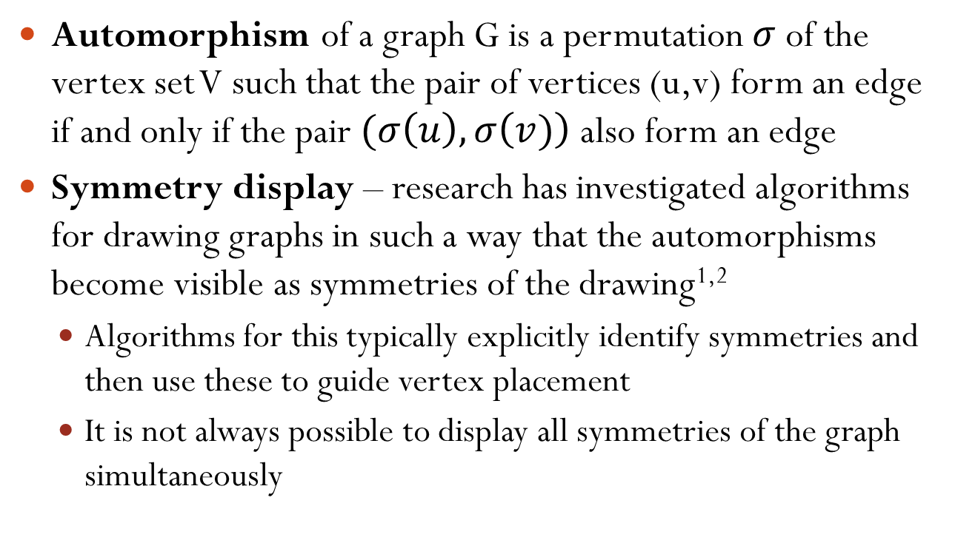
Graph Automorphism
Automorphism of a graph G is a permutation $σ$of the vertex set V such that the pair of vertices (u,v) form an edge if and only if the pair $(σ\left(u\right),σ\left(v)\right)$ also form an edge
Symmetry display – research has investigated algorithms for drawing graphs in such a way that the automorphisms become visible as symmetries of the drawing^{1,2}
Algorithms for this typically explicitly identify symmetries and then use these to guide vertex placement
It is not always possible to display all symmetries of the graph simultaneously
1 - Di Battista, Giuseppe; Tamassia, Roberto; Tollis, Ioannis G. (1992), "Area requirement and symmetry display of planar upward drawings", Discrete and Computational Geometry 7 (1): 381–401
2 - Hong, Seok-Hee (2002), "Drawing Graphs Symmetrically in Three Dimensions", Proc. 9th Int. Symp. Graph Drawing (GD 2001), Lecture Notes in Computer Science, 2265, Springer-Verlag, pp. 106–108

Slide 14
Graph Families by Automorphisms
An asymmetric graph is an undirected graph without any nontrivial automorphisms.
A vertex-transitive graph is an undirected graph in which every vertex may be mapped by an automorphism into any other vertex.
An edge-transitive graph is an undirected graph in which every edge may be mapped by an automorphism into any other edge.
A symmetric graph is a graph such that every pair of adjacent vertices may be mapped by an automorphism into any other pair of adjacent vertices.
A distance-transitive graph is a graph such that every pair of vertices may be mapped by an automorphism into any other pair of vertices that are the same distance apart.

Slide 15
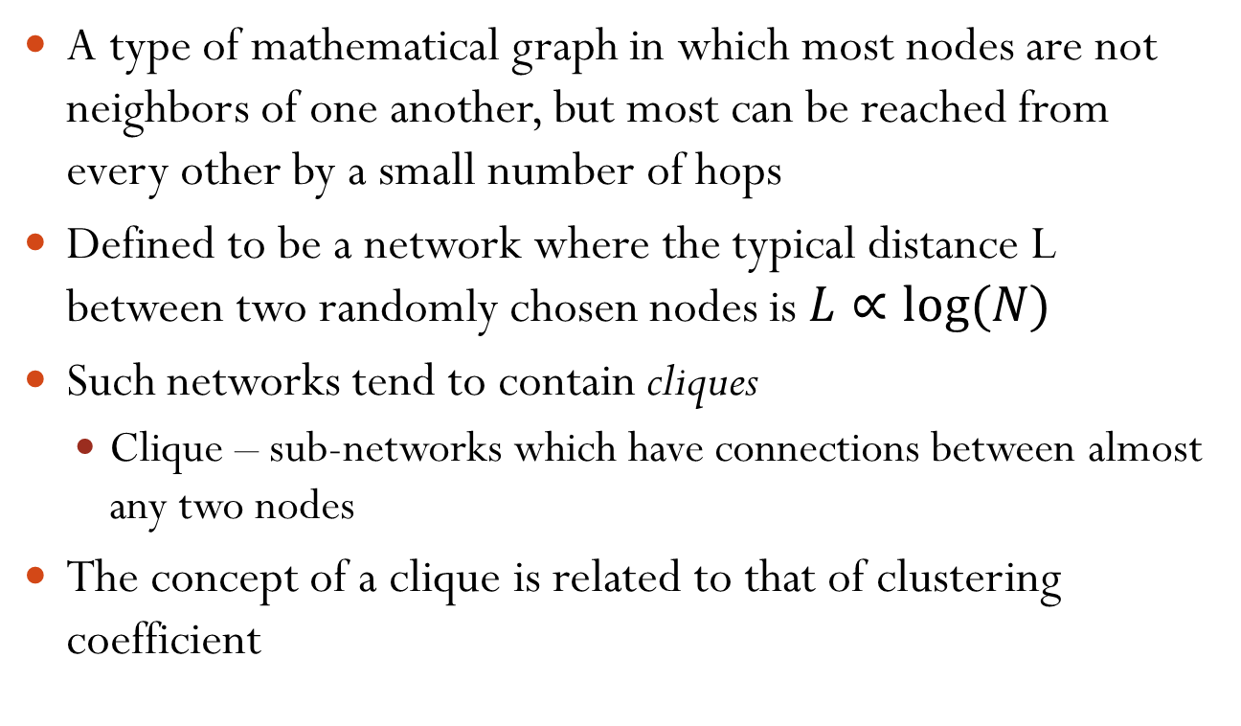
Small-World Network
A type of mathematical graph in which most nodes are not neighbors of one another, but most can be reached from every other by a small number of hops
Defined to be a network where the typical distance L between two randomly chosen nodes is$L∝log⁡(N)$
Such networks tend to contain cliques
Clique – sub-networks which have connections between almost any two nodes
The concept of a clique is related to that of clustering coefficient
D. J. Watts and S. H. Strogatz, “Collective dynamics of `small-world' networks,” Nature, Vol. 393, No. 6684. (4 June 1998), pp. 440-442

Slide 16
Clustering Coefficient
Measure of degree to which nodes in a graph tend to cluster together
Evidence suggests that in most real-world networks (particularly social networks), nodes tend to create tightly knit groups characterized by a high density of ties
This likelihood tends to be greater than the average probability of a tie randomly established between two nodes
There are two types of clustering coefficients
Global clustering coefficient
Local clustering coefficient
Notes:
Important areas in a graph. How dense are the connections?

Slide 17
Global Clustering Coefficient
Based on triplets of nodes
Triplet – three nodes that are connected by either two or three undirected ties
Open triplet – two undirected ties
Closed triplet – three undirected ties
Clustering coefficient is the number of closed triplets over the total number of triplets
R. D. Luce and A. D. Perry (1949). "A method of matrix analysis of group structure". Psychometrika 14 (1): 95–116.

Slide 18
Local Clustering Coefficient
This is measured at the vertex level of a graph
Quantifies how close a vertex’s neighbors are to being a clique (a complete graph)
The neighborhood N_{i} for a vertex v_{i} is defined as its immediately connected neighbors
Let k_{i} be the number of vertices in the neighborhood
The local clustering coefficient for a vertex then is the proportion of links between the vertices within its neighborhood divided by the number of links that could possible exist between them
D. J. Watts and S. H. Strogatz, “Collective dynamics of `small-world' networks,” Nature, Vol. 393, No. 6684. (4 June 1998), pp. 440-442

Slide 19
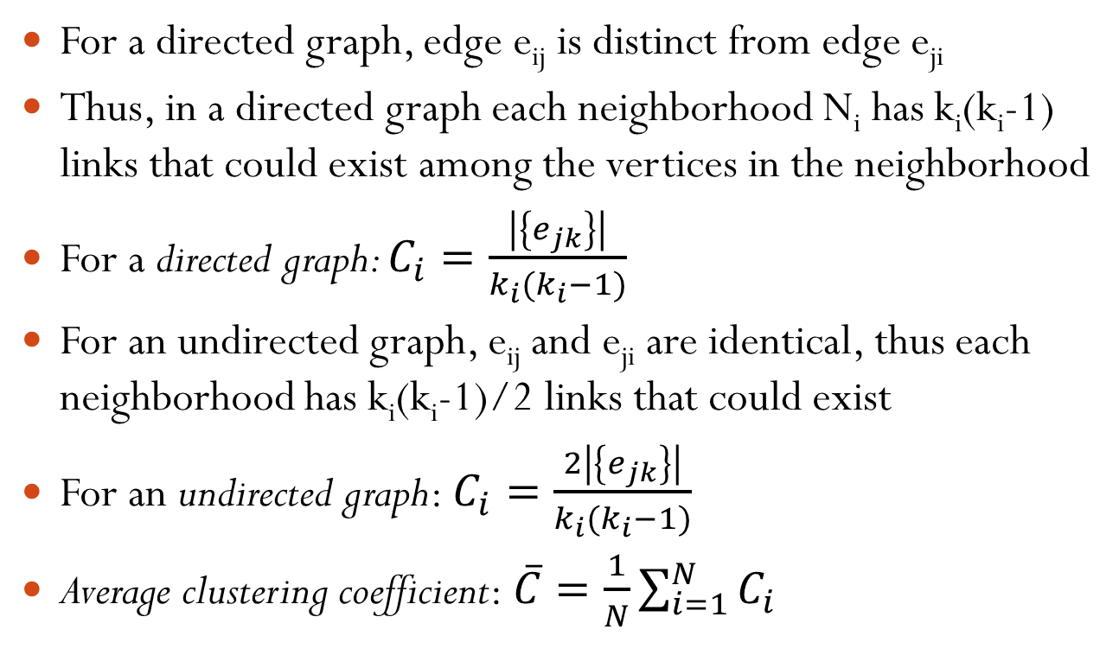
Local Clustering Coefficient
For a directed graph, edge e_{ij} is distinct from edge e_{ji}
Thus, in a directed graph each neighborhood N_{i} has k_{i}(k_{i}-1) links that could exist among the vertices in the neighborhood
For a directed graph: $C_{i}=\frac{\left|\left\{e_{jk}\right\}\right|}{k_{i}(k_{i}−1)}$
For an undirected graph, e_{ij} and e_{ji} are identical, thus each neighborhood has k_{i}(k_{i}-1)/2 links that could exist
For an undirected graph: $C_{i}=\frac{2\left|\left\{e_{jk}\right\}\right|}{k_{i}(k_{i}−1)}$
Average clustering coefficient: $\overline{C}=\frac{1}{N}\sum_{i=1}^{N}{C_{i}}$

Slide 20
Graph Theory Distance Measures
Distance – number of edges in a shortest path connecting two vertices
If there is no path between two vertices, they belong to different connected components and the distance is defined as infinite
Eccentricity – greatest distance between a vertex and any other vertex
Radius – the minimum eccentricity of any vertex
Diameter – the maximum eccentricity of any vertex in the graph
Central vertex – in a graph of radius r, this would be any vertex with a radius of r

Slide 21
Watts-Strogatz Model
Small-World Networks are classified based on their clustering coefficient and their average node-to-node distance
Rado Graphs exhibit a small average shortest path length (varying with the logarithm of the number of nodes) and a small clustering coefficient
Watts and Strogatz measured that many real-world networks have a small average shortest path length, but a clustering coefficient significantly higher than expected by random chance
D. J. Watts and S. H. Strogatz, “Collective dynamics of `small-world' networks,” Nature, Vol. 393, No. 6684. (4 June 1998), pp. 440-442

Slide 22
Watts-Strogatz Model
The classical random graph is the Rado Graph (Erdos-Renyi) offer a simple and powerful model with many applications
However, these graphs do not have two important properties observed in many real-world networks
They do not generate local clustering and triadic closures. As such, they have a low clustering coefficient.
They do not account for the formation of hubs. The degree distribution of Rado Graphs converges to a Poisson distribution rather than a power law distribution observed in many real-world networks
D. J. Watts and S. H. Strogatz, “Collective dynamics of `small-world' networks,” Nature, Vol. 393, No. 6684. (4 June 1998), pp. 440-442

Slide 23
Watts-Strogatz Model
Designed as a simple model to address the first of the limitations
Goal is to account for clustering while retaining the short average path lengths
Does so by interpolating between a Rado graph and a regular ring lattice
This model is able to partially explain small-world phenomena in power grids, movie actor networks and others
D. J. Watts and S. H. Strogatz, “Collective dynamics of `small-world' networks,” Nature, Vol. 393, No. 6684. (4 June 1998), pp. 440-442

Slide 24
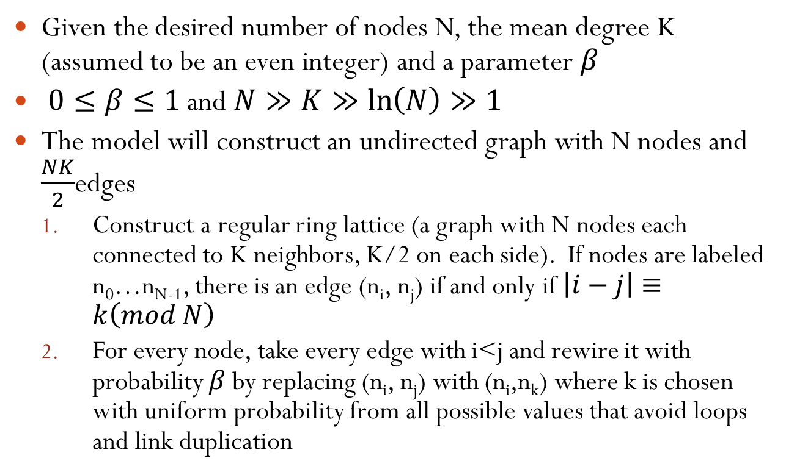
Watts-Strogatz Algorithm
Given the desired number of nodes N, the mean degree K (assumed to be an even integer) and a parameter $β$
$0≤β≤1$ and $N≫K≫\ln\left(N\right)≫1$
The model will construct an undirected graph with N nodes and $\frac{NK}{2}$edges
Construct a regular ring lattice (a graph with N nodes each connected to K neighbors, K/2 on each side). If nodes are labeled n₀…n_{N-1}, there is an edge (n_{i}, n_{j}) if and only if $\left|i−j\right|≡k\left(mod N\right)$
For every node, take every edge with i<j and rewire it with probability $β$ by replacing (n_{i}, n_{j}) with (n_{i},n_{k}) where k is chosen with uniform probability from all possible values that avoid loops and link duplication
D. J. Watts and S. H. Strogatz, “Collective dynamics of `small-world' networks,” Nature, Vol. 393, No. 6684. (4 June 1998), pp. 440-442

Slide 25
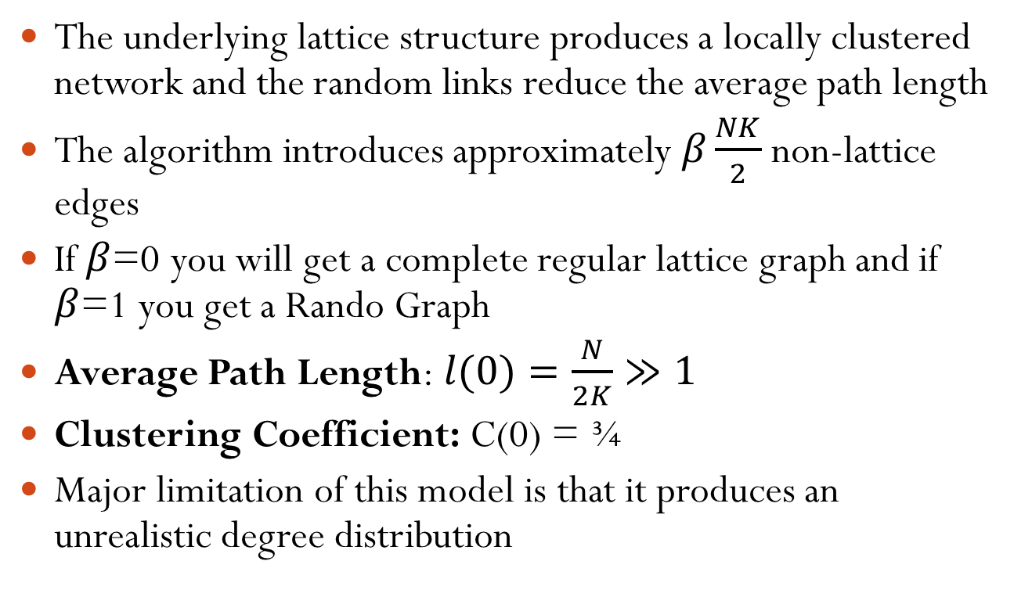
Watts-Strogatz Algorithm Properties
The underlying lattice structure produces a locally clustered network and the random links reduce the average path length
The algorithm introduces approximately $β\frac{NK}{2}$ non-lattice edges
If $β$=0 you will get a complete regular lattice graph and if $β$=1 you get a Rando Graph
Average Path Length: $l(0)=\frac{N}{2K}≫1$
Clustering Coefficient: C(0) = ¾
Major limitation of this model is that it produces an unrealistic degree distribution
D. J. Watts and S. H. Strogatz, “Collective dynamics of `small-world' networks,” Nature, Vol. 393, No. 6684. (4 June 1998), pp. 440-442

Slide 26
Applications of Small-World Networks
These networks allow for the modeling of real-world phenomenon
Often, we are trying to visualize some real world process or help analysts understand such processes
If we can provide extra information about their networks, we can help them further develop their hypotheses
Small-world networks are found in sociology, relating to social movement groups
Found in earth sciences with networks that define fracture systems and porous substances
Many other examples!!

Slide 27
Graph Centrality
Another means of characterizing nodes is based on their relative importance in the graph
To do this, we utilize measures of centrality that were first developed in social network analysis
There are four measures of centrality that are widely used:
Degree centrality
Closeness
Betweenness
Eigenvector Centrality
Notes:
Try to determine relationship between other nodes

Slide 28
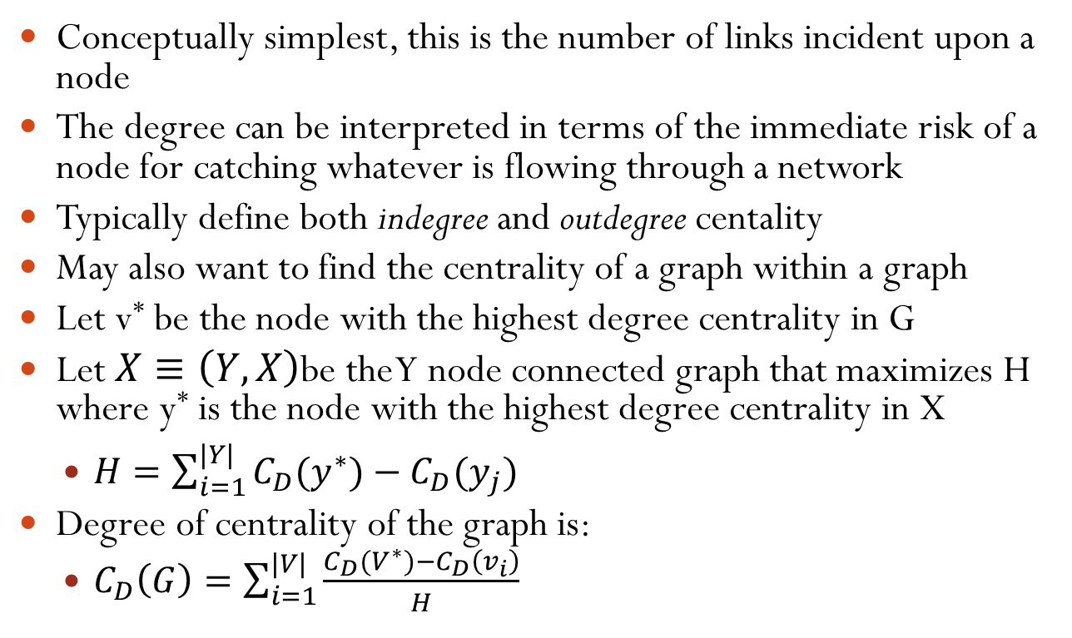
Degree Centrality
Conceptually simplest, this is the number of links incident upon a node
The degree can be interpreted in terms of the immediate risk of a node for catching whatever is flowing through a network
Typically define both indegree and outdegree centality
May also want to find the centrality of a graph within a graph
Let v* be the node with the highest degree centrality in G
Let $X≡\left(Y,X\right)$be the Y node connected graph that maximizes H where y* is the node with the highest degree centrality in X
$H=\sum_{i=1}^{|Y|}{C_{D}(y^{∗})−C_{D}(y_{j})}$
Degree of centrality of the graph is:
$C_{D}\left(G\right)=\sum_{i=1}^{|V|}{\frac{C_{D}(V^{∗})−C_{D}\left(v_{i}\right)}{H}}$

Slide 29
Closeness Centrality
In graphs, there is a natural distance metric between nodes
This is the length of their shortest paths
Farness: Sum of the distances to all other nodes
Closeness: The inverse of farness
Can be regarded as a measure of how long it will take to spread information from a starting node to all other nodes
The more central a node is, the lower its total distance to all other nodes

Slide 30
Random-Walk Centrality
Classically, the spread of something is done through the shortest path; however, this might not be realistic
Random-walk centrality measures the speed with which randomly walking messages reach a vertex from elsewhere in the network
There are many variations of a random-walk model, the one-dimensional case would be moving an integer on a number line, at each iteration it moves +1 or -1 with equal probability
Similarly in a network, at each stage, we could move to any connected node with equal probability
J. D. Noh and H. Rieger, Phys. Rev. Lett. 92, 118701 (2004)

Slide 31
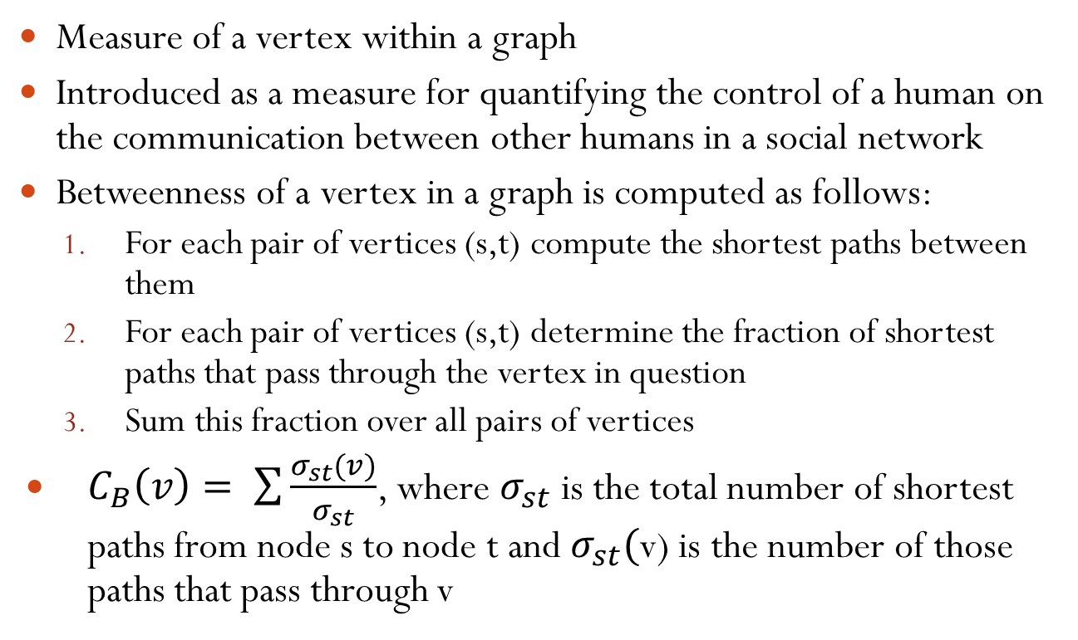
Betweenness Centrality
Measure of a vertex within a graph
Introduced as a measure for quantifying the control of a human on the communication between other humans in a social network
Betweenness of a vertex in a graph is computed as follows:
For each pair of vertices (s,t) compute the shortest paths between them
For each pair of vertices (s,t) determine the fraction of shortest paths that pass through the vertex in question
Sum this fraction over all pairs of vertices
$C_{B}\left(v\right)= \sum{\frac{σ_{st}(v)}{σ_{st}}}$, where $σ_{st}$is the total number of shortest paths from node s to node t and $σ_{st}($v) is the number of those paths that pass through v

Slide 32
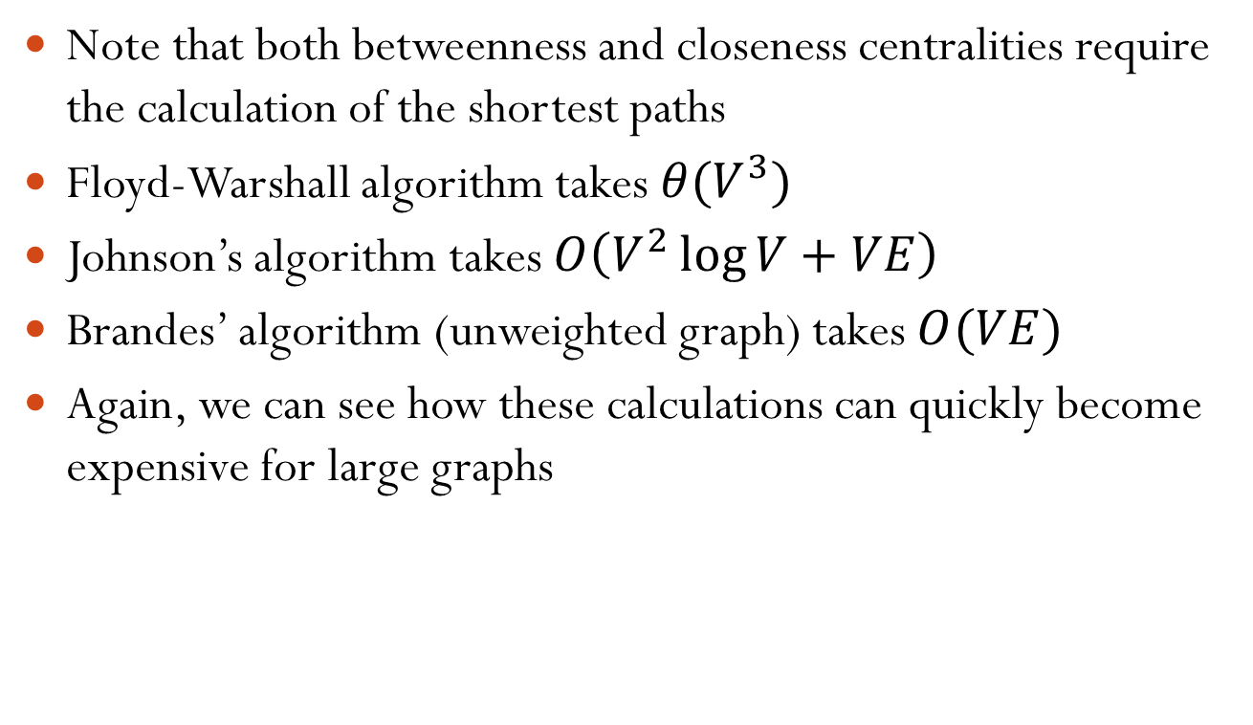
Shortest Paths
Note that both betweenness and closeness centralities require the calculation of the shortest paths
Floyd-Warshall algorithm takes $θ(V^{3})$
Johnson’s algorithm takes $O\left(V^{2}\log{V}+VE\right)$
Brandes’ algorithm (unweighted graph) takes $O(VE)$
Again, we can see how these calculations can quickly become expensive for large graphs

Slide 33
Floyd-Warshall Algorithm
We assume that the input is represented by a weight matrix W= (w_{ij})_{i,j in E} that is defined by :
w_{ij}= 0 if i=j
w_{ij}= w(i,j) if i≠j and (i,j) in E
w_{ij}= ∞ if i≠j and (i,j) not in E
If the graph has n vertices, we return a distance matrix (d_{ij}), where d_{ij} the length of the path from i to j.
Without loss of generality, we will assume that V={1,2,…,n}, i.e., that the vertices of the graph are numbered from 1 to n.
Given a path p=(v₁, v₂,…, v_{m}) in the graph, we will call the vertices v_{k} with index k in {2,…,m-1} the intermediate vertices of p.

Slide 34
Floyd-Warshall Algorithm
The key to the Floyd-Warshall algorithm is the following definition:
Let d_{ij}^{(k)} denote the length of the shortest path from i to j such that all intermediate vertices are contained in the set {1,…,k}.
A shortest path does not contain any vertex twice, as this would imply that the path contains a cycle. By assumption, cycles in the graph have a positive weight, so removing the cycle would result in a shorter path, which is impossible.

Slide 35
Floyd-Warshall Algorithm
Consider a shortest path p from i to j such that the intermediate vertices are from the set {1,…,k}.
If the vertex k is not an intermediate vertex on p
d_{ij}^{(k)} = d_{ij}^{(k-1)}
If the vertex k is an intermediate vertex on p
d_{ij}^{(k)} = d_{ik}^{(k-1)} + d_{kj}^{(k-1)}
Therefore, we can conclude that
d_{ij}^{(k)} = min{d_{ij}^{(k-1)} , d_{ik}^{(k-1)} + d_{kj}^{(k-1)}}

Slide 36
Floyd-Warshall Algorithm
Floyd-Warshall(W)
n = # of rows of W;
D⁽⁰⁾ = W;
for k = 1 to n do
for i = 1 to n do
for j = 1 to n do
d_{ij}^{(k)} = min{d_{ij}^{(k-1)} , d_{ik}^{(k-1)} + d_{kj}^{(k-1)}};
od;
od;
od;
return D^{(n)};

Slide 37
Eigenvector Centrality
Measure of the influence of a node in a network
Assigns relative scores to all nodes in the network based on the concept that connections to high-scoring nodes contribute more to the score of the node in question
Google’s pagerank algorithm is a variant of the eigenvector centrality measure

Slide 38
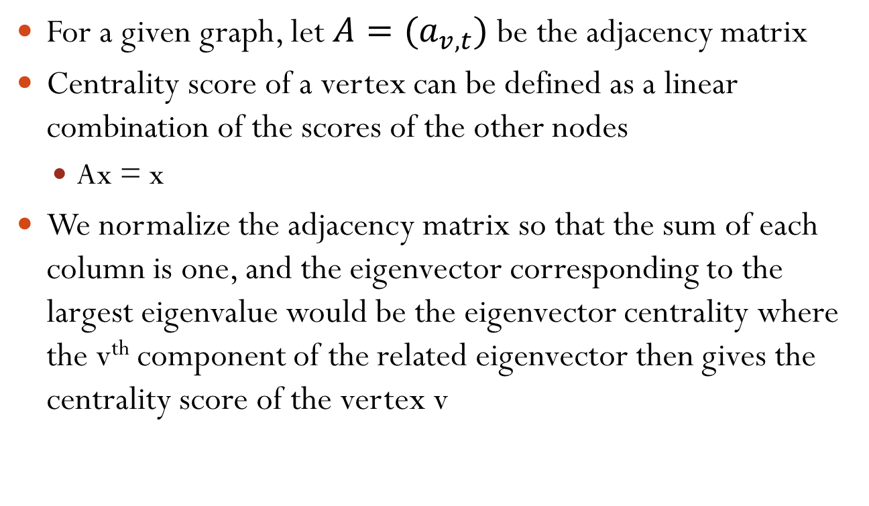
Eigenvector Centrality
For a given graph, let $A=(a_{v,t})$ be the adjacency matrix
Centrality score of a vertex can be defined as a linear combination of the scores of the other nodes
Ax = x
We normalize the adjacency matrix so that the sum of each column is one, and the eigenvector corresponding to the largest eigenvalue would be the eigenvector centrality where the v^{th} component of the related eigenvector then gives the centrality score of the vertex v

Slide 39
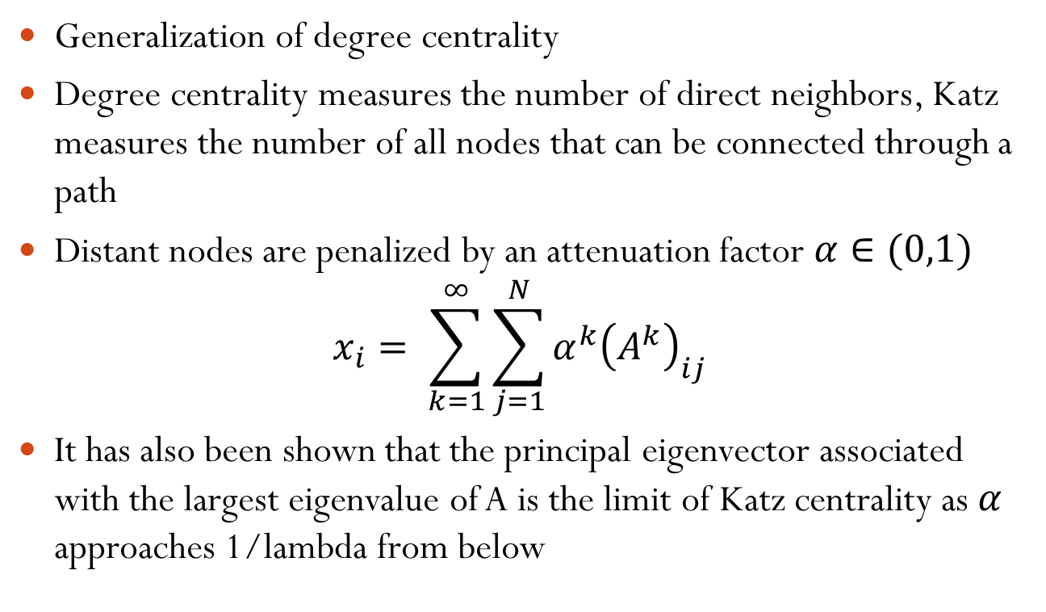
Katz Centrality
Generalization of degree centrality
Degree centrality measures the number of direct neighbors, Katz measures the number of all nodes that can be connected through a path
Distant nodes are penalized by an attenuation factor $α∈(0,1)$
$$x_{i}= \sum_{k=1}^{∞}{\sum_{j=1}^{N}{α^{k}{\left(A^{k}\right)}_{ij}}}$$
It has also been shown that the principal eigenvector associated with the largest eigenvalue of A is the limit of Katz centrality as $α$ approaches 1/lambda from below
Katz, L. 1953. A New Status Index Derived from Sociometric Index. Psychometrika, 39-43.

Slide 40
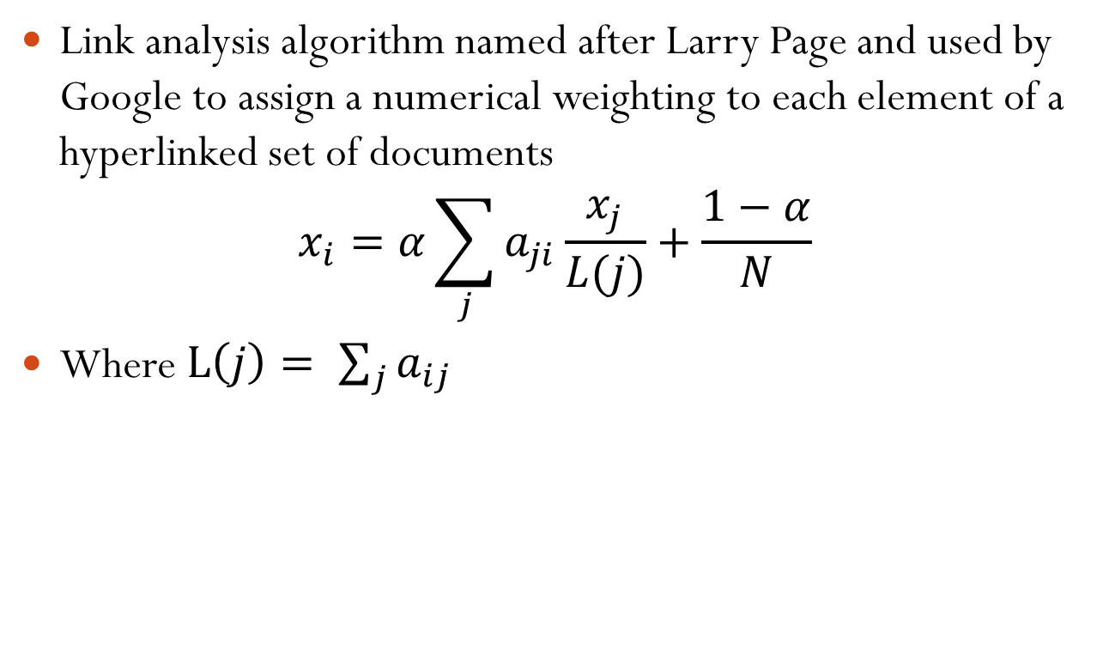
Page Rank
Link analysis algorithm named after Larry Page and used by Google to assign a numerical weighting to each element of a hyperlinked set of documents
$$x_{i}=α\sum_{j}{a_{ji}\frac{x_{j}}{L(j)}}+\frac{1−α}{N}$$
Where $L\left(j\right)= \sum_{j}{a_{ij}}$
Brin, S.; Page, L. (1998). "The anatomy of a large-scale hypertextual Web search engine". Computer Networks and ISDN Systems 30: 107–117

Slide 41
What Tools Are Available?
NodeXL - http://nodexl.codeplex.com/
Plug-in for MS Excel
Includes many network layout and network analysis metrics
Data import:
List out vertices and edges in Excel columns
Native importers for email, Twitter, YouTube, etc.
Ploceus
Framework and system for modeling and visualizing tabular data as network
Models data as a graph

Slide 42
Readings and Homework
Required Reading:
D. J. Watts and S. H. Strogatz, “Collective dynamics of `small-world' networks,” Nature, Vol. 393, No. 6684. (4 June 1998), pp. 440-442
Frank van Ham, Martin Wattenberg: Centrality Based Visualization of Small World Graphs. Comput. Graph. Forum 27(3): 975-982 (2008)

